Slide 1
Computer Security Essentials
Joel Garmon
Director Information Security
Garmonjs@wfu.edu

Slide 2
Agenda
Confidential Information
Encryption
Email Security
Laptop Security
Patching and Anti-Virus
Mobile Media
Wi-Fi
Phishing
Miscellaneous

Slide 3
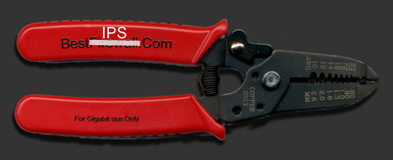
The Ultimate Firewall and Security Device
Marcus Raynum – Inventor of Firewalls
Installation Instructions
For best effect install the firewall between the CPU unit and the wall outlet. Place the jaws of the firewall across the power cord, and bear down firmly. Be sure to wear rubber gloves while installing the firewall or assign the task to a junior system manager. If the firewall is installed properly, all the lights on the CPU will turn dark and the fans will grow quiet. This indicates that the system has entered a secure state
The fact is, that if you're connecting your network to anything else, you're running a risk. Period. Usually, that risk can be reduced, often dramatically, by employing basic security precautions such as firewalls. But a firewall is a risk reduction system, it is not a risk mitigation system -- there is, always, some danger that something can go fatally wrong with anything built by humans.
The firewall above is the only 100% guaranteed secure solution.
http://www.ranum.com/security/computer_security/papers/a1-firewall/

Slide 4
Confidential Information
Legally required to protect
  Social Security Number
  Other personally identifiable information such as driver’s license
  Student records (FERPA)
Contractually required to protect
  Credit card number
  R&D information under contract

Slide 5
Confidential Information (cont’d)
Business information
  Financial
  HR related
  Salary
  Intellectual property
    R&D
    Patents
    Trade Secrets

Slide 6
File Level vs Whole Disk Encryption
Encrypt sensitive data
Two types of encryption to protect differently
  Most users need both methods
File level encryption
  Encrypts individual files or folders
  Very fast and not noticeable by users
  May be password protected
  Can be used to send encrypted information depending on the method used
    PKZip, Winzip – encrypted on the computer and when stored using other storage device or transmitted by email, FTP, …
    MS Encrypted file system (EFS) – only encrypted when in the current location on the computer

Slide 7
File Level vs Whole Disk Encryption
Encrypt the entire hard drive
  Protects against stolen device and hacker attempting to circumvent the login process
  Initial encryption can take several hours but should not be noticeable after that
  Does not protect information that is transmitted
  Normally provides ‘safe harbor’ for legal and regulatory reporting if sensitive information is lost

Slide 8
Email
Email is ‘best effort’ delivery system, not guaranteed
Sensitive data is normally not secure/protected
  Users encrypt the files or data
    WinZip, PKZip, …
    Can use ‘self decrypting’ file
    Do NOT send the password in the same email
  Products to automatically encrypt emails
    From specific users
    With certain words or patterns
      SSN, Private
    User manual action
    Zixmail, Postini, Iron Mail, …

Slide 9
Laptop Security
Physical protection is paramount
  Never leave it visible in a vehicle
If you have confidential information
  Must encrypt the hard drive
    CheckPoint PointSec, MS BitLocker – Commercial product, more reliable, enterprise quality
    TrueCrypt – Freeware version
Never store the only copy of irreplaceable data on a laptop or PC
  Keep copies on servers which are backed up
Don’t let kids or others use corporate laptop

Slide 10
Patching and Anti-Virus
Patch – a fix to a problem in an application or operating system such as MS Windows XP
  Un-patched systems are significant exposure to hackers
  Most corporate computers configured to automatically download and install security patches
  Insure that your home PC is also patched
Anti-Virus –
  Detects known attacks
    According to Mandiant Consulting, AV detects only about 25-50%
  Must be updated daily
  Should run weekly (at least) full hard drive scan
  Most corporate computers configured to perform this
  Free AV at Microsoft.com
More security, patching and AV information at http://www.microsoft.com/security

Slide 11
Mobile Media
Smart phones, iPad, …
  Confidential information on devices
  Encrypt data on device including emails
  Need password protection
  Allow remote wipe of data
  Backup of data
    Where is this data stored and what is the security
    Is any confidential data stored at the backup site
  Be very leery of adding applications to devices
    iPhone App store or Droid Marketplace have some security review
    Recent discovery of malicious apps on Droid Marketplace and removed

Slide 12
Wi-Fi
Wireless Fidelity – a group of technical standards enabling the transmission of data over wireless networks
If communication not encrypted, then possible to “sniff” traffic
  Starbucks, McDonalds, hotel, …
  Immediately start VPN on laptops to protect sessions
For home wireless routers
  Configure for automatic encryption
    WPA2 is best, but use any available on router
    Keeps your neighbor from using your bandwidth and slowing down your network ☺
  Use a service set identifier (SSID) name not associated with you
    Do not ‘broadcast’ your SSID

Slide 13
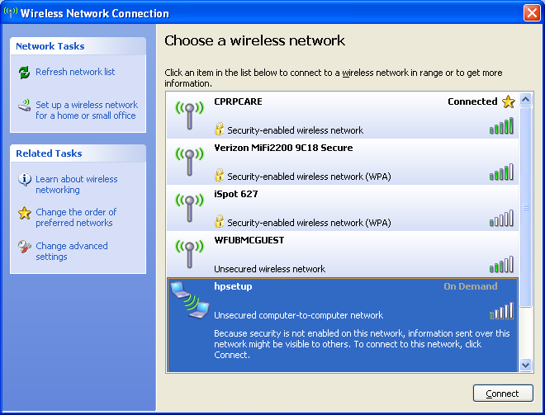
Wi-Fi- Connection Example
Be careful on which connection you select!

Slide 14
Phishing
The fraudulent practice of sending emails purporting to be from legitimate companies in order to induce individuals to reveal personal information, such as credit card numbers; user name and password; etc
Phishing can be very creative and innovative in asking for your personal information
Legitimate company will never ask for sensitive or personal information in email
  May ask you to go to web site or call
  Always verify information such as phone number from bill or go to known web site. Example: bbt.com

Slide 15
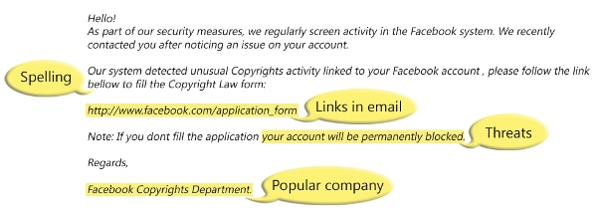
Phishing example
HERE IS AN EXAMPLE OF WHAT A PHISHING SCAM IN AN EMAIL MESSAGE MIGHT LOOK LIKE.
http://www.microsoft.com/security/online-privacy/phishing-symptoms.aspx

Slide 16
Recent Example
Date: Tue, Jun 14, 2011 at 10:38 AM
Subject: Your OWA (Outlook Web Access) Will Be Deactivated Soon
To:
Dear Email Users,
This Message is IT System, Helpdesk. The major project of upgrading the email servers to Microsoft Exchange 2011 (from Exchange 2003/2007) is in progress. Mailbox moves have been completed, you only need to complete the below information to Activate. Immediately the information is received, mailbox moves will begin shortly and storage space will increase from 500MB to 1GB. OWA (Outlook Web Access) accessed will begin, please kindly fill with valid information by clicking on the link below:
http://2011outlook.at.ua/outlook.htm
Our goal is to have your email account moves completed before 48 hours. You will receive an e-mail in a couple of hours when your mailbox account is moved. Inability to complete information on the form within 48 hours you receive this e-mail will render your e-mail in-active from our database.
Regards,
Helpdesk! Account Services
While not aimed at WFU, their timing was very lucky

Slide 17
Miscellaneous
Passwords
  Never share, you are responsible for what occurs with your account
  If you give someone your password or think it has been compromised you should immediately change it
Flash Drives
  Should not use same device for home and work
    Significant vector for introducing virus
  Use encrypted flash drives for confidential information

Slide 18
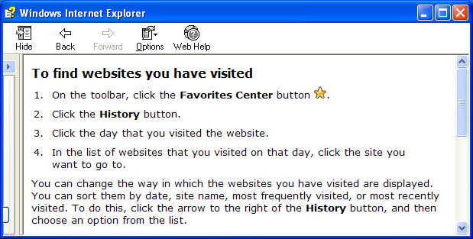
Children and Internet
Keep computers for children’s use in common areas of the house
Parental controls product reviews
http://www.wellresearchedreviews.com/computer-monitoring/?id=18&s=google&gclid=COy5pY6xmqkCFZJe7AodPU2ttg
Periodically review Internet history

Slide 19
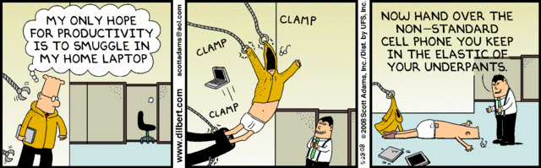
Questions?

